Slide 1


Axel Mukwena
13 September 2022

Slide 2

Outline
Executive Summary
Introduction
Methodology
Results
Conclusion
Appendix

Slide 3
Executive Summary
Summary of methodologies
Data Collection through API
Data Collection with Web Scraping
Data Wrangling
Exploratory Data Analysis with SQL
Exploratory Data Analysis with Data Visualization
Interactive Visual Analytics with Folium
Machine Learning Prediction
Summary of all results
Exploratory Data Analysis result
Interactive analytics in screenshots
Predictive Analytics result

Slide 4
Introduction
Project background and context
The Falcon 9 is a reusable two-stage rocket designed and manufactured by SpaceX to reliably and safely transport people and payloads to Earth orbit and beyond. The Falcon 9 is the world’s first reusable orbital-class rocket. Reusability allows SpaceX to remanufacture the most expensive parts of the rocket, which in turn reduces the cost of access to space. Therefore, if we can determine if the first stage will land, we can determine the cost of a launch. This goal of the project is to create a machine learning pipeline to predict if the first stage will land successfully.
Problems you want to find answers
The effect each relationshop with certain rocket variables will impact determining the success rate of a successful landing, and what conditions does SpaceX have to achieve to get the best results

Slide 5

Section 1

Slide 6
Methodology
Executive Summary
Data collection methodology:
SpaceXAPI(https://api.spacexdata.com/v4/rockets/)
WebScraping
Perform data wrangling
Identified missing values
Replace missing values with mean
Identifies Null Values
Created a training label class.

Slide 7
Methodology
Executive Summary
Perform exploratory data analysis (EDA) using visualization and SQL
Perform interactive visual analytics using Folium and Plotly Dash
Perform predictive analysis using classification models
Data that was collected until this step were normalized, divided in training and test data sets and evaluated by four different classification models, being the accuracy of each model evaluated using different combinations of parameters.

Slide 8
Data Collection
Datasets collected from:
SpaceX API (https://api.spacexdata.com/v4/rockets/)
Wikipedia (https://en.wikipedia.org/wiki/List_of_Falcon_9_and_Falcon_Heavy_launches), using web scraping.

Slide 9
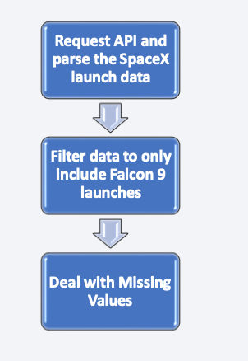
Data Collection – SpaceX API
Using a SpaceX public API, like flowchart:
Source code:
https://github.com/heliospjunior/IBM-Data-Science-Capstone-SpaceX/blob/main/spacex-data-collection-api.ipynb

Slide 10
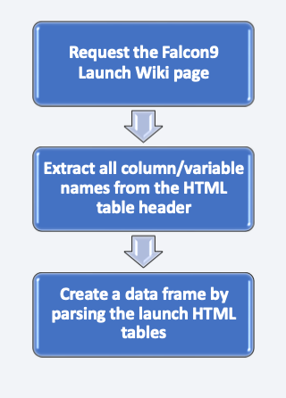
Data Collection - Scraping
• Data from SpaceX launches obtained from Wikipedia, used like flowchart:.
• Source code:
https://github.com/heliospjunior/IBM-Data-Science-Capstone-SpaceX/blob/main/webscraping.ipynb

Slide 11
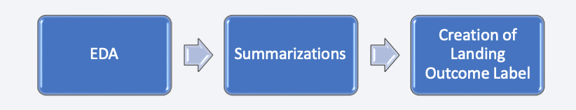
Data Wrangling
Collect data, analysis and check missing data and data types,clean and format data types, change data types if necessary, summary launches per site, and outcome label created from outcome product.
Source code:
https://github.com/heliospjunior/IBM-Data-Science-Capstone-SpaceX/blob/main/spacex-Data%20wrangling.ipynb

Slide 12
EDA with Data Visualization
Scatterplots and bar plots were used to visualize the relationship between pair of features:
Payload Mass X Flight Number,
Launch Site X Flight Number
Launch Site X Payload Mass
Orbit and Flight Number
Payload and Orbit
Bar plots were used to visualize the relationship between pair of features:
Mean X Orbit
Line Graphs were used to visualize the relationship between pair of features:
Mean X Orbit
Source code: https://github.com/SouRitra01/IBM-Data-Science- Project/blob/main/EDA%20with%20Data%20Visualization.ipynb

Slide 13
EDA with SQL
SQL queries performed:
Display the names of the unique launch sites in the space mission;
Display the top 5 launch sites whose name begins with the string 'CCA’;
Display total pay load mass carried by boosters launched by NASA (CRS);
Average payload mass carried by booster version F9 v1.1;
Date of the first successful landing outcome in ground pad;
Listing names of the boosters which have success in drone ship with payload mass between 4000-6000 kg;
Total number of successful and failure mission outcomes;
Listing names of the booster versions which have carried the maximum payload mass;
Failed landing out comes in droneship, their booster versions, and launch site names for in year 2015; and
Rank of the count of landing outcomes (such as Failure (droneship) or Success (ground pad)) between the date 2010-06-04 and 2017-03-20.
Source code: https://github.com/heliospjunior/IBM-Data-Science-Capstone-SpaceX/blob/main/eda-sql.ipynb

Slide 14
Build an Interactive Map with Folium
Launch success rate may depend on the location and proximity of a launch site
Markers, circles, lines and marker clusters were used with Folium Interative Maps
Using Folium library, identified all SpaceX launch sites on a map
Marker clusters indicates groups of events in each coordinate, like launches in a launch site; and
lines are used to indicate distances between two coordinates.
Source code: https://github.com/heliospjunior/IBM-Data-Science-Capstone-SpaceX/blob/main/launch_site_location.ipynb

Slide 15
Build a Dashboard with Plotly Dash
Build an interactive dashboard with Plotly Dash including:
Dropdown menu for select sites
Pie charts displaying success rate.
Scatter graph with the relationship about Outcome and Payload Mass (Kg) for the different booster version.
Range Slider for select range of payload mass (Kg)

Slide 16
Predictive Analysis (Classification)
EDA using numpy and pandas, transforme data and split our data into training and testing.
Built some machine learning models and tune different hyperparameters using GridSearchCV.
Used accuracy as the metric for our model, improved the model using feature engineering and algorithm tuning.
Found the best performing classification model.

Slide 17
Results
Exploratory data analysis results:
Space X uses 4 different launch sites;
The first launches were done to Space X itself and NASA;
The average payload of F9 v1.1 booster is 2,928 kg;
The first success landing outcome happened in 2015 fiver year after the first launch;
Many Falcon 9 booster versions were successful at landing in drone ships having payload above the average;
Almost 100% of mission outcomes were successful;
The number of landing outcomes became as better as years passed.
Using interactive analytics was possible to identify that launch sites use to be in safety places, near sea, for example and have a good logistic infrastructure around.
Most launches happens at east cost launch sites.

Slide 18

Section 2

Slide 19

Flight Number vs. Launch Site
CCAFS-SL 40 is the most used launch site.
CCAFS-SLC 40 has most of failures in the early stage of Falcon9

Slide 20
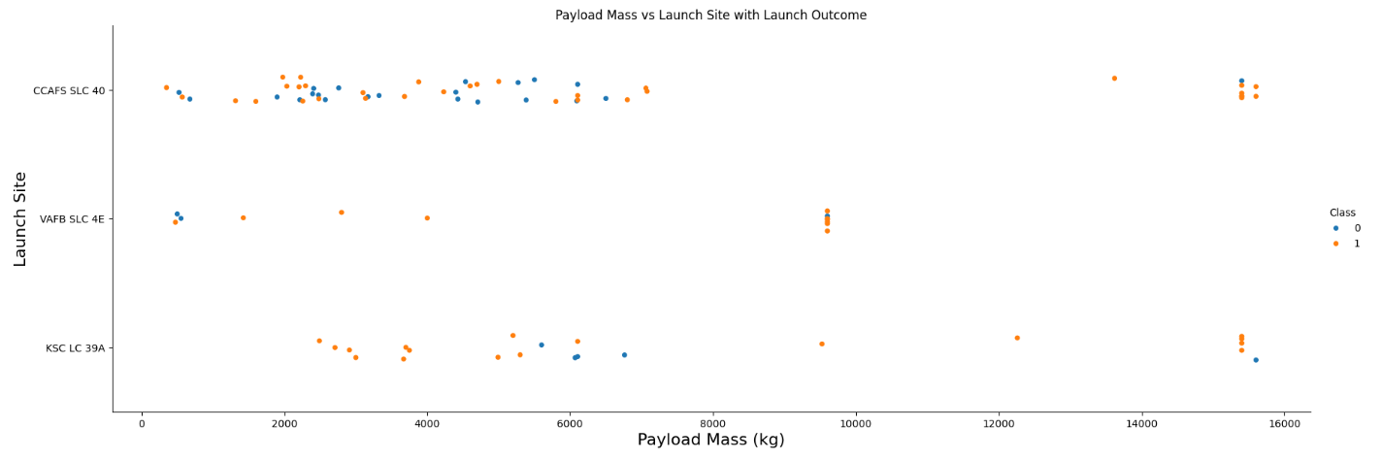
Payload vs. Launch Site
Falcon9 specifications, heavy payloads sent to low/medium orbits.
The percentage of failures is lower for heavy payloads.
Success Rate X Payload Orbit needed some more information.

Slide 21
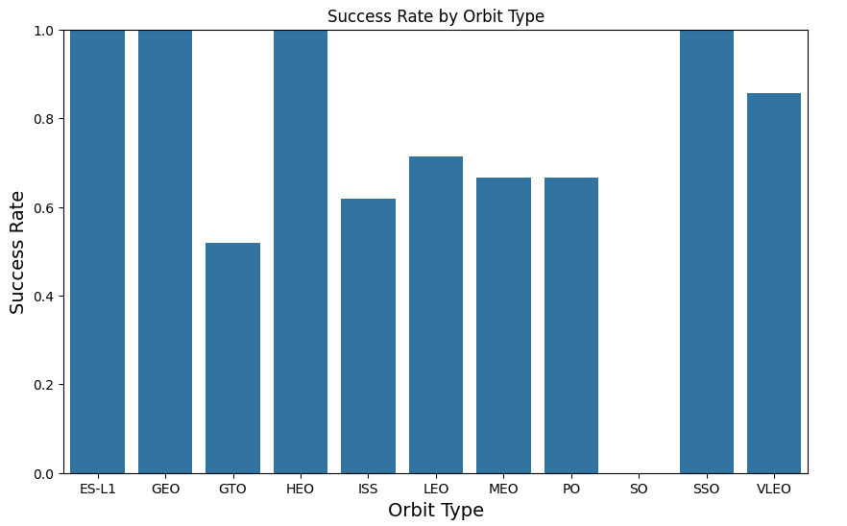
Success Rate vs. Orbit Type
From the plot, we can see that ES-L1, GEO, HEO, SSO, VLEO had the most success rate.
GTO sees the lowesr success rate

Slide 22
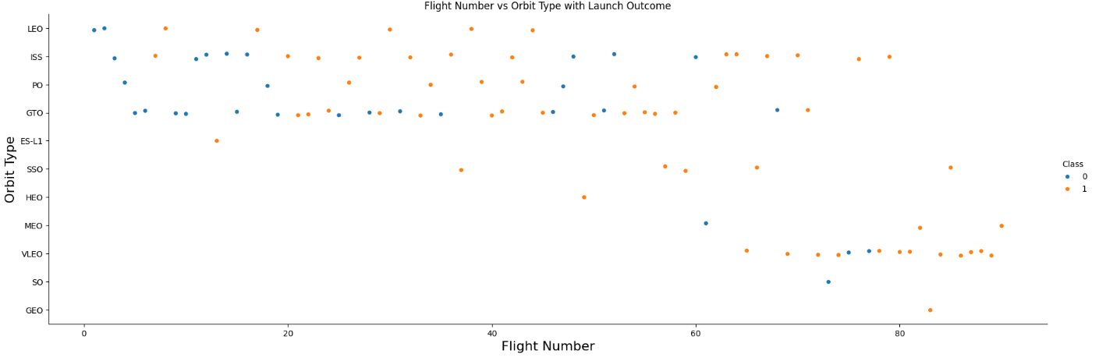
Flight Number vs. Orbit Type
In the LEO orbit, success is related to the number of flights whereas in the GTO orbit, there is no relationship between flight number and the orbit.

Slide 23
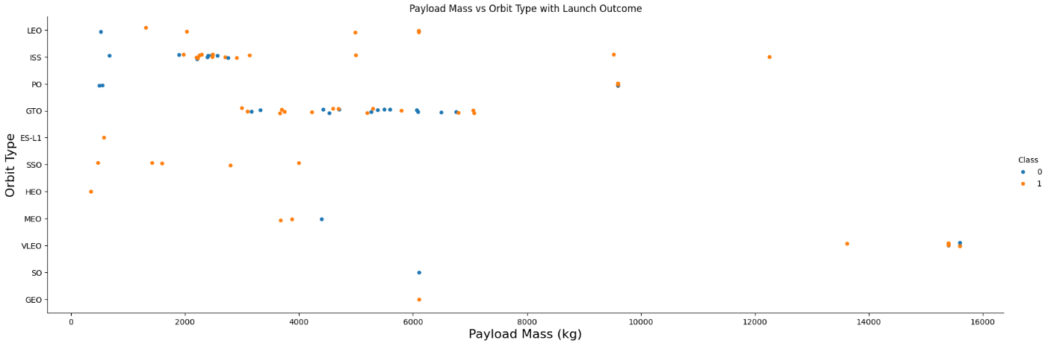
Payload vs. Orbit Type
Max Success rate with low orbit, except ISS and low payload mass
Between 2000-7500 ks, success rate seems to be distributed for GTO

Slide 24
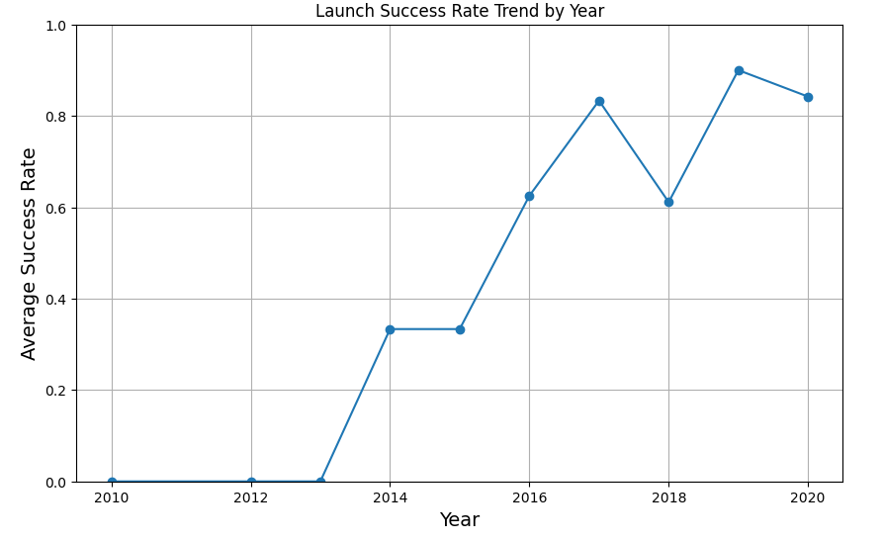
Launch Success Yearly Trend
The success rate since 2013 kept on increasing till 2020.
Falcon9 average booster recovery success rate 66%

Slide 25
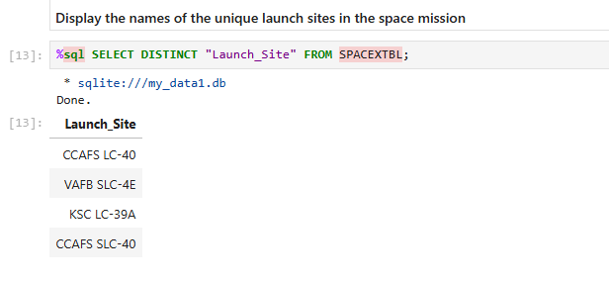
All Launch Site Names
With DISTINCT we show only unique launch sites from the SpaceX data.

Slide 26
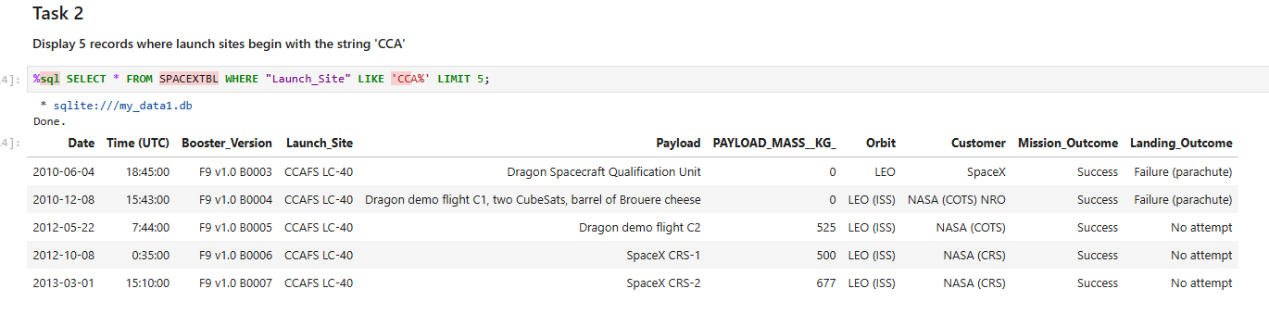
Launch Site Names Begin with 'CCA'
Query to display 5 records where launch sites begin with `CCA`

Slide 27
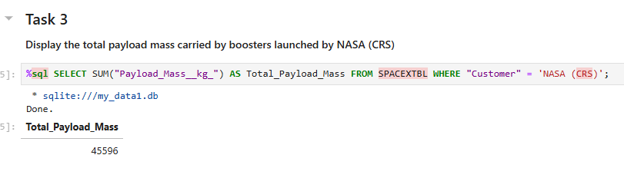
Total Payload Mass
Total payload carried by boosters from NASA as 45596 using the query below

Slide 28
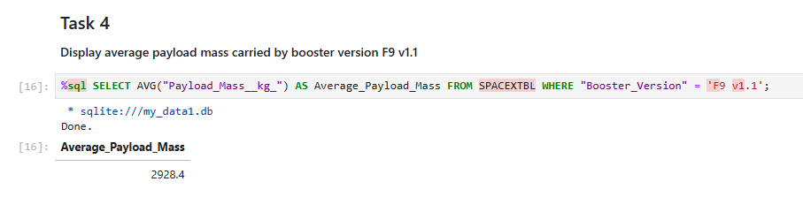
Average Payload Mass by F9 v1.1
Calculated the average payload mass carried by booster version F9 v1.1 as 2928.4

Slide 29
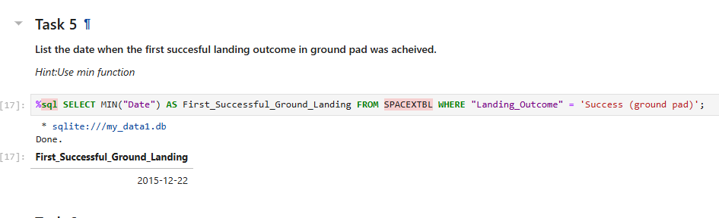
First Successful Ground Landing Date
The dates of the first successful landing outcome on ground pad was 22nd December 2015

Slide 30
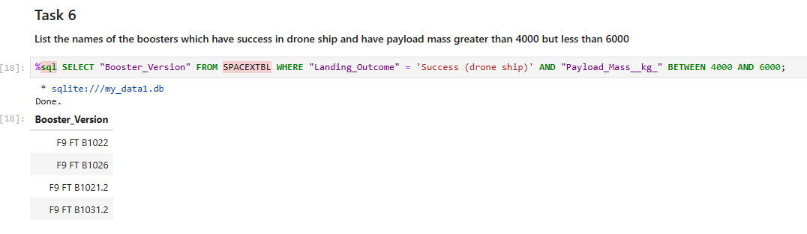
Successful Drone Ship Landing with Payload between 4000 and 6000

Slide 31

Total Number of Successful and Failure Mission Outcomes
Wildcard like ‘%’ to filter for WHERE MissionOutcome was a success or a failure.

Slide 32
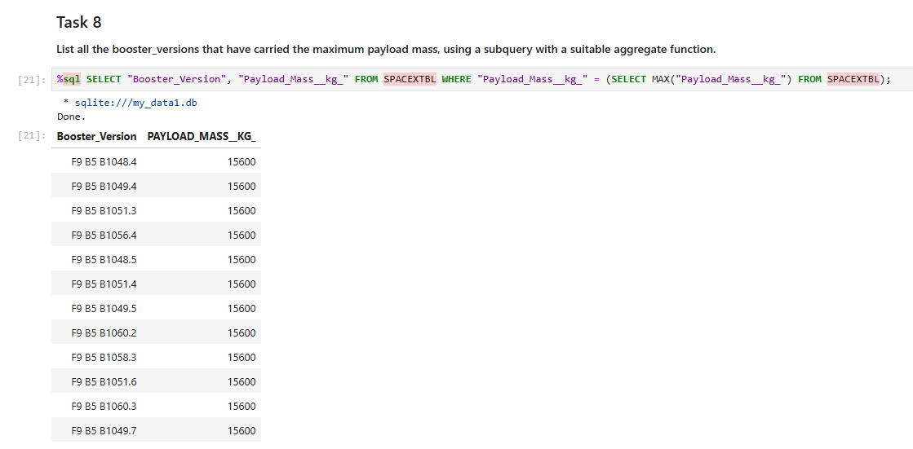
Boosters Carried Maximum Payload
The booster that have carried the maximum payload using a subquery in the WHERE clause and the MAX() function.

Slide 33
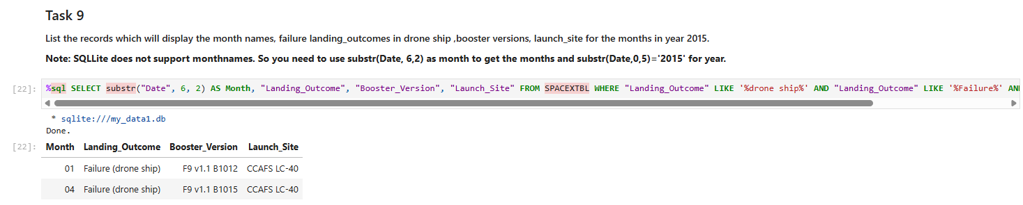
2015 Launch Records
Used WHERE clause, LIKE, AND, and BETWEEN conditions to filter for failed landing outcomes in drone ship, their booster versions, and launch site names for year 2015

Slide 34
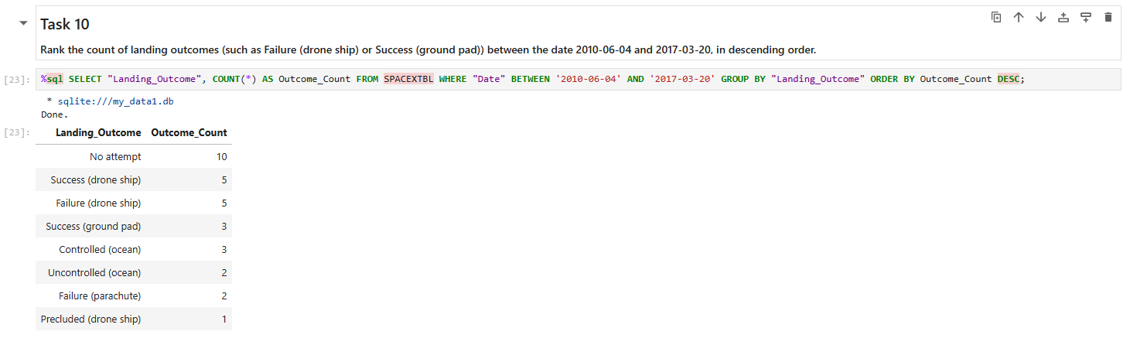
Rank Landing Outcomes Between 2010-06-04 and 2017-03-20
Applied the GROUP BY clause to group the landing outcomes and the ORDER BY clause to order the grouped landing outcome in descending order.

Slide 35

Section 3

Slide 36
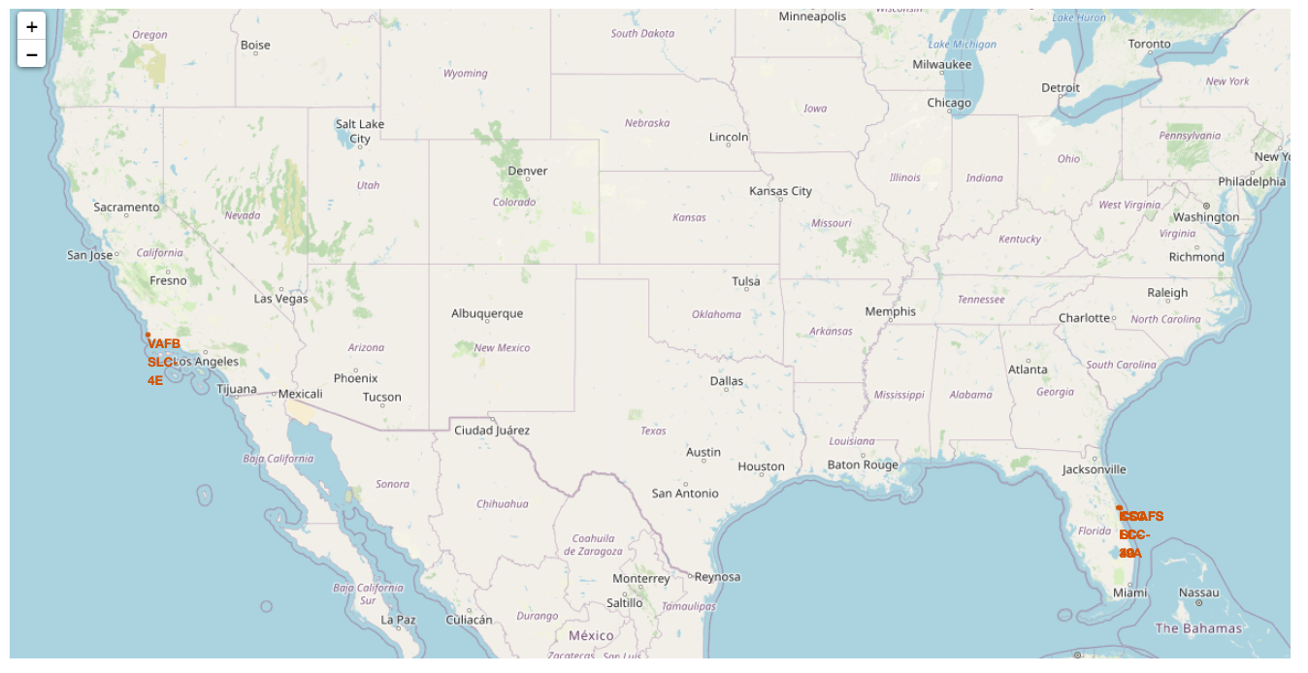
Launch sites global map
We can see the Space X launch sites in the USA coasts.

Slide 37

Markers showing launch sites with color labels

Slide 38

Launch Site distance to landmarks

Slide 39

Section 4

Slide 40

Pie chart showing the success percentage achieved by each launch site

Slide 41

Pie chart showing the Launch site with the highest launch success ratio

Slide 42

Scatter plot of Payload vs Launch Outcome for all sites, with different payload selected in the range slider

Slide 43

Section 5

Slide 44
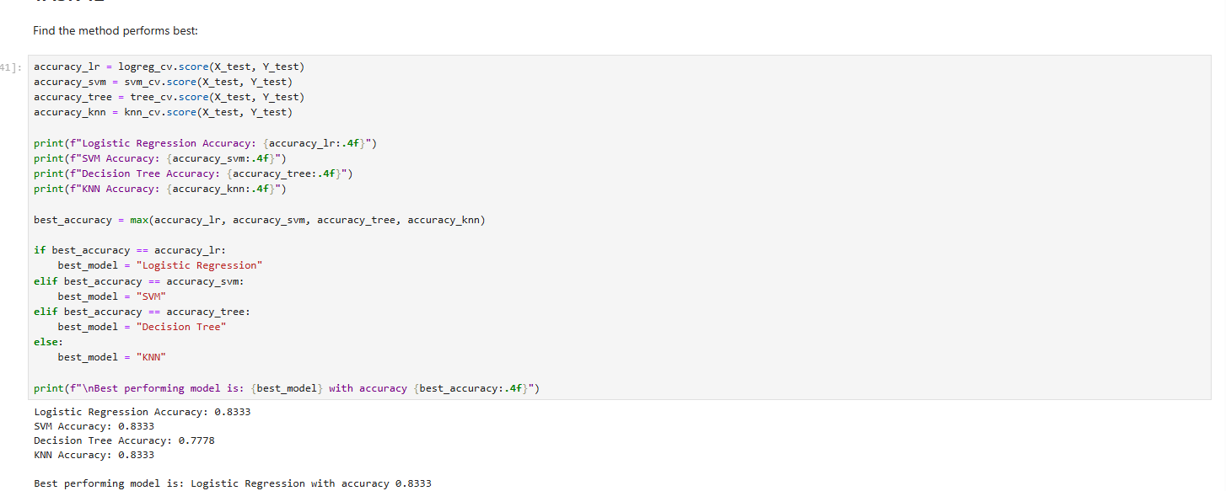
Classification Accuracy
The Logistic Regression classifier is the model with the highest classification accuracy

Slide 45

Confusion Matrix
The confusion matrix for the decision tree classifier shows distinguish between different classes.
A problem is the false positives, unsuccessful landing marked as successful landing by the classifier.

Slide 46
Conclusions
The larger the flight amount at a launch site, greater is the success rate
Orbits ES-L1, GEO, HEO, SSO, VLEO had the most success rate.
KSC LC-39A had the most successful launches of any sites.
Success rate started to increase in 2013 till 2020.
The Decision tree classifier is the best tool for this task.

Slide 47


